Slide 1
MODULE two: profiling
Speaker, Date
Notes:
Screenshots are all taken from Nsight systems profiler on Ubuntu 18.04
Feel free to update the screenshots, or hide some of them, or use a different profiler tool that you prefer.

Slide 2
Module OVERVIEW
Topics to be covered
Compiling and profiling sequential code
Explanation of multicore programming
Compiling and profiling multicore code
Notes:
This Module was originally designed for the PGI compiler. Added NVIDIA HPC Compiler slides to it

Slide 3
Compiling sequential code
Notes:
Simply how to compiler C/C++ code. For the most part, students will be able to use Makefiles for lab exercises, and do not have to worry about compiling the codes themselves.

Slide 4
NVIDIA’S HPC COMPILERS (aka PGI)
NVIDIA Compiler Names (PGI names still work)
nvc - The command to compile C code (Formerly Known As ‘pgcc’)
nvc++ - The command to compile C++ code (Formerly Known As ‘pgc++’)
nvfortran - The command to compile Fortran code (Formerly Known As ‘pgfortran/pgf90/pgf95/pgf77)
The -fast flag instructs the compiler to optimize the code to the best of its abilities
$ pgcc –fast main.c
$ pgc++ -fast main.cpp
$ pgfortran –fast main.F90

Slide 5
NVIDIA’S HPC COMPILERS (aka PGI)
-Minfo flag
The Minfo flag will instruct the compiler to print feedback about the compiled code
-Minfo=accel will give us information about what parts of the code were accelerated via OpenACC
-Minfo=opt will give information about all code optimizations
-Minfo=all will give all code feedback, whether positive or negative
$ pgcc –fast –Minfo=all main.c
$ pgc++ -fast -Minfo=all main.cpp
$ pgfortran –fast –Minfo=all main.f90
Notes:
-Minfo=accel will only show any feedback if there are OpenACC optimizations.
-Minfo=opt will give us a lot of information regarding optimizations (this includes non-parallel optimizations as well!)
-Minfo=all will give more feedback, and will even give feedback about the sequential code. It can be overwhelming for individuals who are not used to things such as loop unrolling, or fused instructions. It will also give negative feedback (where code couldn’t be optimized, for example)

Slide 6
GCC Compiler Basics
gcc, gc++ and gfortran
The command to compile C code is ‘gcc’
The command to compile C++ code is ‘g++’
The command to compile Fortran code is ‘gfortran’
The -O2 flag sets the optimization level to 2 (a safe starting point)
$ gcc -O2 main.c
$ g++ -O2 main.cpp
$ gfortran -O2 main.F90

Slide 7
GCC Compiler Basics
Compiler feedback
The -fopt-info flag will print limited compiler feedback
The -flto-report flag will also print link-time optimizations, but should be used sparingly due to volume of information
$ gcc -O2 –fopt-info main.c
$ g++ -O2 –fopt-info main.cpp
$ gfortran -O2 –fopt-info main.f90
Notes:
-Minfo=accel will only show any feedback if there are OpenACC optimizations.
-Minfo=opt will give us a lot of information regarding optimizations (this includes non-parallel optimizations as well!)
-Minfo=all will give more feedback, and will even give feedback about the sequential code. It can be overwhelming for individuals who are not used to things such as loop unrolling, or fused instructions. It will also give negative feedback (where code couldn’t be optimized, for example)

Slide 8
NVIDIA NSIGHT Family
Notes:
To start with, we moved away from nvprof to nvidia nsight family
Profiling is the first step in optimizing and tuning your application. Profiling an application would help us understand where most of the execution time is spent. You will gain an understanding of its performance characteristics and can easily identify parts of the code that present opportunities for improvement. Finding hotspots and bottlenecks in your application, can help you decide where to focus our optimization efforts.
NVIDIA offers Nsight tools (Nsight Systems, Nsight Compute, Nsight Graphics), a collection of applications which enable developers to debug, profile the performance of CUDA, OpenACC, or OpenMP applications.

Slide 9
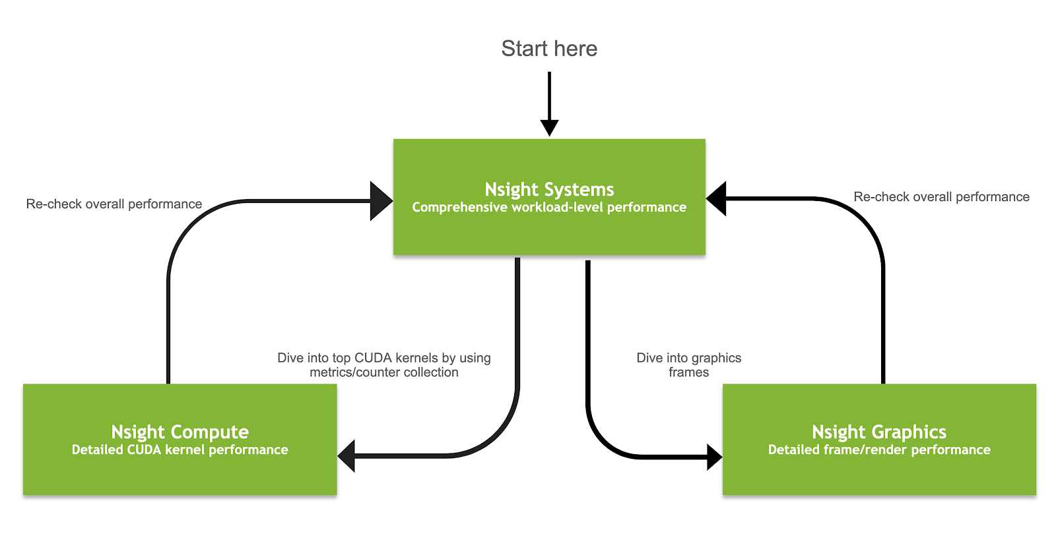
Nsight Product Family
Workflow
Nsight Systems - Analyze application algorithm system-wide
Nsight Compute - Debug/optimize CUDA kernel
Nsight Graphics - Debug/optimize graphics workloads
This material is released by NVIDIA Corporation under the Creative Commons Attribution 4.0 International (CC BY 4.0)
Notes:
The is the programming model, we suggest you to use when optimizing your code now
You start with Nsight Systems to get a system-level overview of the workload and eliminate any system level bottlenecks, such as unnecessary thread synchronization or data movement, and improve the system level parallelism of your algorithms. Once you have done that, then proceed to Nsight Compute or Nsight Graphics to optimize the most significant CUDA kernels or graphics workloads, respectively. Periodically return to Nsight Systems to ensure that you remain focused on the largest bottleneck. Otherwise the bottleneck may have shifted and your kernel level optimizations may not achieve as high of an improvement as expected.

Slide 10
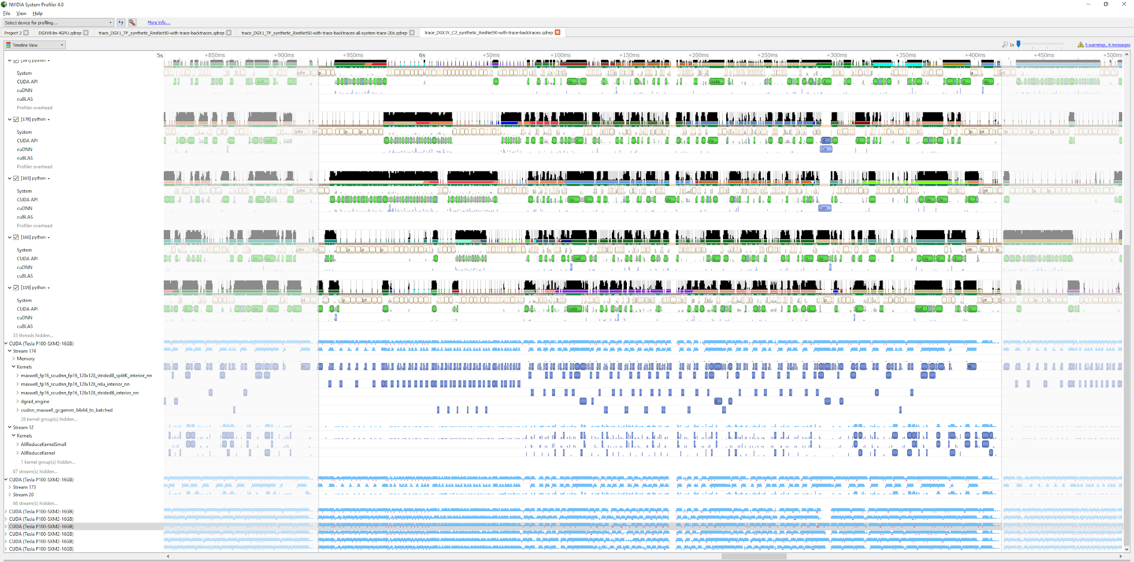
Thread/core migration
Processes and
threads
Thread state
CUDA and OpenGL API trace
cuDNN and cuBLAS trace
Kernel and memory transfer activities
Multi-GPU
This material is released by NVIDIA Corporation under the Creative Commons Attribution 4.0 International (CC BY 4.0)

Slide 11
Profiling sequential code
Notes:
Running sequential code before any code edits to get baseline results.

Slide 12
Openacc development CYCLE
Analyze your code to determine most likely places needing parallelization or optimization.
Parallelize your code by starting with the most time consuming parts, check for correctness and then analyze it again.
Optimize your code to improve observed speed-up from parallelization.
Analyze
Analyze
Optimize
Parallelize
Notes:
This is the OpenACC development cycle. Analyze -> Parallelize -> Optimize. Rinse and repeat. It is slightly over-simplified, however. It is very important to profile you code before beginning, however, it is equally important to continue profiling your code as you make changes. It is important to verify that changes you are making are impacting the code in a way that you expected.
The Modules are designed to follow this format. This Module will include the Analyze portion. We are expecting students to profile for every module, however.

Slide 13
Profiling sequential code
Step 1: Run Your Code
Terminal Window
Record the time it takes for your sequential program to run.
$ pgcc –fast jacobi.c laplace2d.c
$ ./a.out
0, 0.250000
100, 0.002397
200, 0.001204
300, 0.000804
400, 0.000603
500, 0.000483
600, 0.000403
700, 0.000345
800, 0.000302
900, 0.000269
total: 39.432648 s
Note the final results to verify correctness later.
Always run a problem that is representative of your real jobs.
Notes:
3 main takeaways from this slide:
We need to know the application runtime to compare against later. If the program doesn’t have built-in timers the UNIX time command can be used, but in real applications this is often not representative of the important part of the code because it include initial, one-time setup and teardown. It’s best to add a timer around the core of the program, such as a timestepping loop.
Running faster doesn’t matter if your answers aren’t correct. Get a baseline of what the expected results are so that at each step you can verify that your changes still produce correct results.
You want to run a problem that executes fairly quickly, but it still needs to be realistic. For instance, we don’t want to cut back the size of our computation, but we may want to reduce the number of steps. Running a significantly smaller problem may emphasize different parts of the code than a full problem, leading to wasted effort.

Slide 14
Profiling sequential code
Step 2: Profile Your Code
Sample Code: Conjugate Gradient
Obtain detailed information about how the code ran.
Total Runtime: 22.38 seconds
This can include information such as:
Total runtime
Runtime of individual routines
Hardware counters
The “matvec” function is our dominate hotspot
Identify the portions of code that took the longest to run. We want to focus on these “hotspots” when parallelizing.
Notes:
The chart is from another sample code, one that the students are not expected to work with. We will create a similar graph with our lab code once we explain the profiling process.

Slide 15
Profiling with NSIGHT SYSTEM and NVTX

Slide 16
Profiling Sequential code
Using Command Line Interface (CLI)
NVIDIA Nsight Systems CLI provides
Simple interface to collect data
Can be copied to any system and analysed later
Profiles both serial and parallel code
For more info enter nsys --help on the terminal
To profile a serial application with NVIDIA Nsight Systems, we use NVIDIA Tools Extension (NVTX) API functions in addition to collecting backtraces while sampling.
Notes:
We use nsight system command line to collect data and we use NVTX API functions to collect backtraces while sampling
To learn more about the options, you can use nsys --help

Slide 17
Profiling Sequential code
NVIDIA Tools Extension API (NVTX) library
What is it?
A C-based Application Programming Interface (API) for annotating events
Can be easily integrated to the application
Can be used with NVIDIA Nsight Systems
Why?
Allows manual instrumentation of the application
Allows additional information for profiling (e.g: tracing of CPU events and time ranges)
How?
Import the header only C library nvToolsExt.h
Wrap the code region or a specific function with nvtxRangePush() and nvtxRangPop()

Slide 18
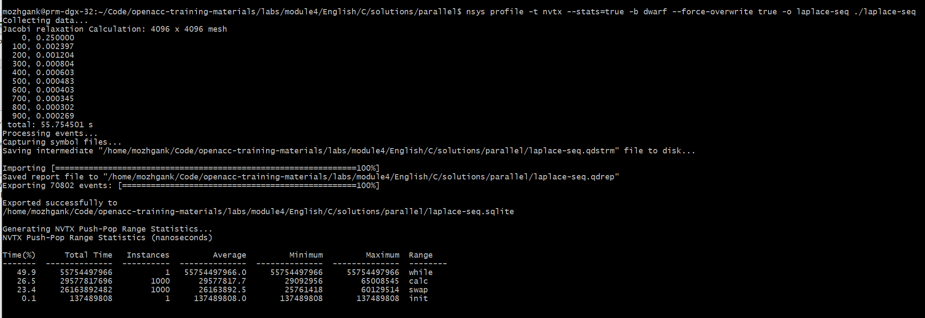
-t | Selects the APIs to be traced (nvtx in this example)
--status | if true, generates summary of statistics after the collection
-b | Selects the backtrace method to use while sampling. The option dwarf uses DWARF's CFI (Call Frame Information).
--force-overwrite | if true, overwrites the existing results
-o | sets the output (qdrep) filename
#include <string.h>
#include <stdio.h>
#include <stdlib.h>
#include <omp.h>
#include "laplace2d.h"
#include <nvtx3/nvToolsExt.h>
int main(int argc, char** argv)
{
const int n = 4096;
const int m = 4096;
const int iter_max = 1000;
const double tol = 1.0e-6;
double error = 1.0;
double *restrict A = (double*)malloc(sizeof(double)*n*m);
double *restrict Anew = (double*)malloc(sizeof(double)*n*m);
nvtxRangePushA("init");
initialize(A, Anew, m, n);
nvtxRangePop();
printf("Jacobi relaxation Calculation: %d x %d mesh\n", n, m);
double st = omp_get_wtime();
int iter = 0;
nvtxRangePushA("while");
while ( error > tol && iter < iter_max )
{
nvtxRangePushA("calc");
error = calcNext(A, Anew, m, n);
nvtxRangePop();
nvtxRangePushA("swap");
swap(A, Anew, m, n);
nvtxRangePop();
if(iter % 100 == 0) printf("%5d, %0.6f\n", iter, error);
iter++;
}
nvtxRangePop();
double runtime = omp_get_wtime() - st;
printf(" total: %f s\n", runtime);
deallocate(A, Anew);
return 0;
}
NVTX range statistics
“calc” region (calcNext function) takes 26.6%
“swap” region (swap function) takes 23.4% of total execution time
Open laplace-seq.qdrep with Nsight System GUI to view the timeline
jacobi.c
(starting and ending of ranges are highlighted with the same color)
Notes:
On the left, you can see the use of nvtx apis in the example jacobi code . And on the right, we see the screenshot of profiling it with nsys
Once you profile it with nsight system command line, it generates a qdrep file that you can later open it and view it in the nsight gui

Slide 19
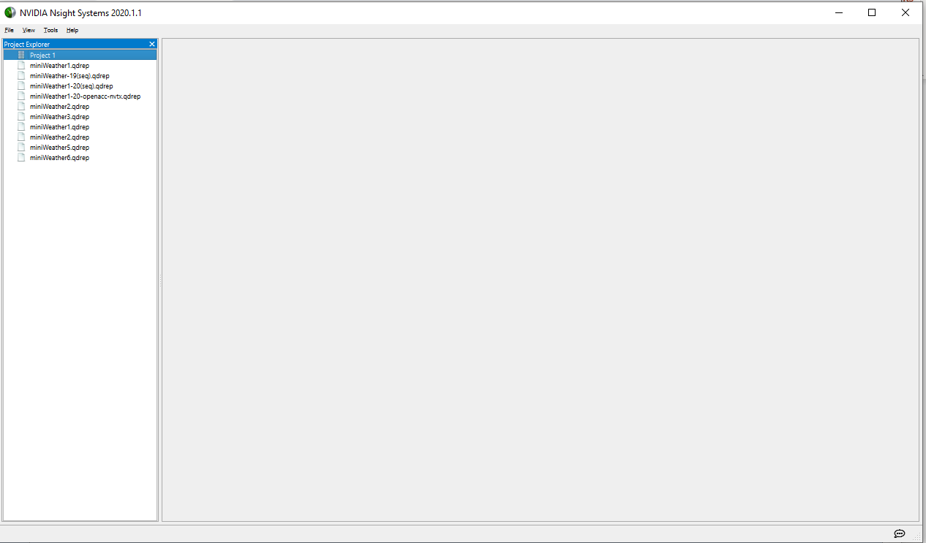
Profiling Sequential code
Using Nsight Systems
Open the generated report files (*.qdrep) from command line in the Nsight Systems profiler.
File > Open
Notes:
You can open the qdrep file in nsight, clicking file / open, make sure that you have the nsight installed on your machine

Slide 20
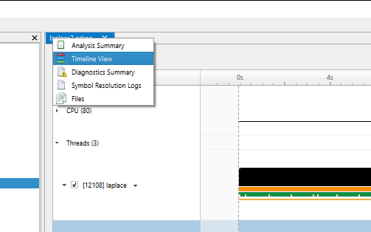
Profiling Sequential code
Using Nsight Systems
Navigate through the “view selector”.
“Analysis summary” shows a summary of the profiling session. To review the project configuration used to generate this report, see next slide.
“Timeline View” contains the timeline at the top, and a bottom pane that contains the events view and the function table.
Read more: https://docs.nvidia.com/nsight-systems
Notes:
And here you can navigate through the view selector to check the diagnostic summary or timeline view and there are other reports available as you can see

Slide 21
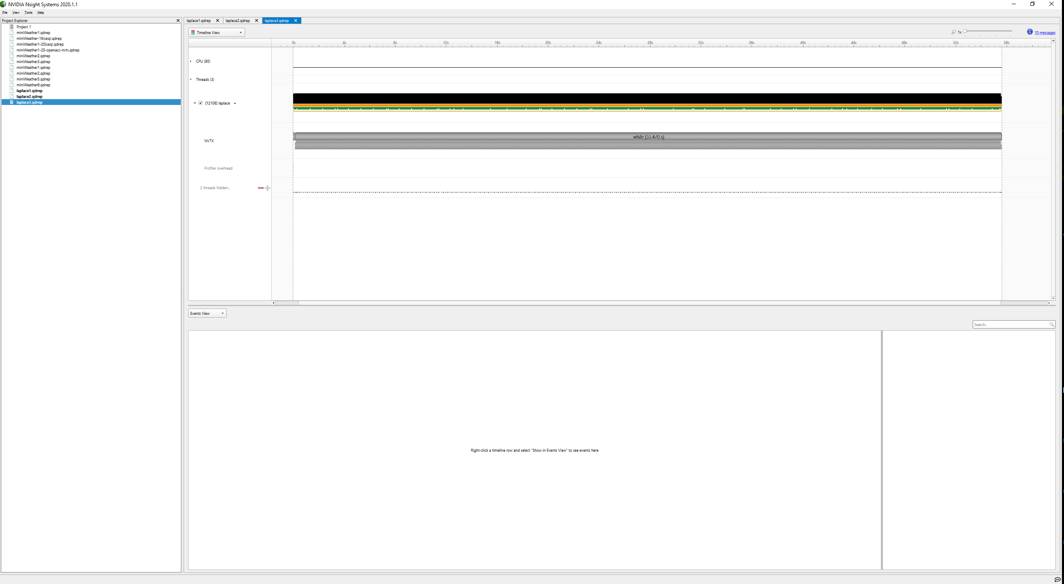
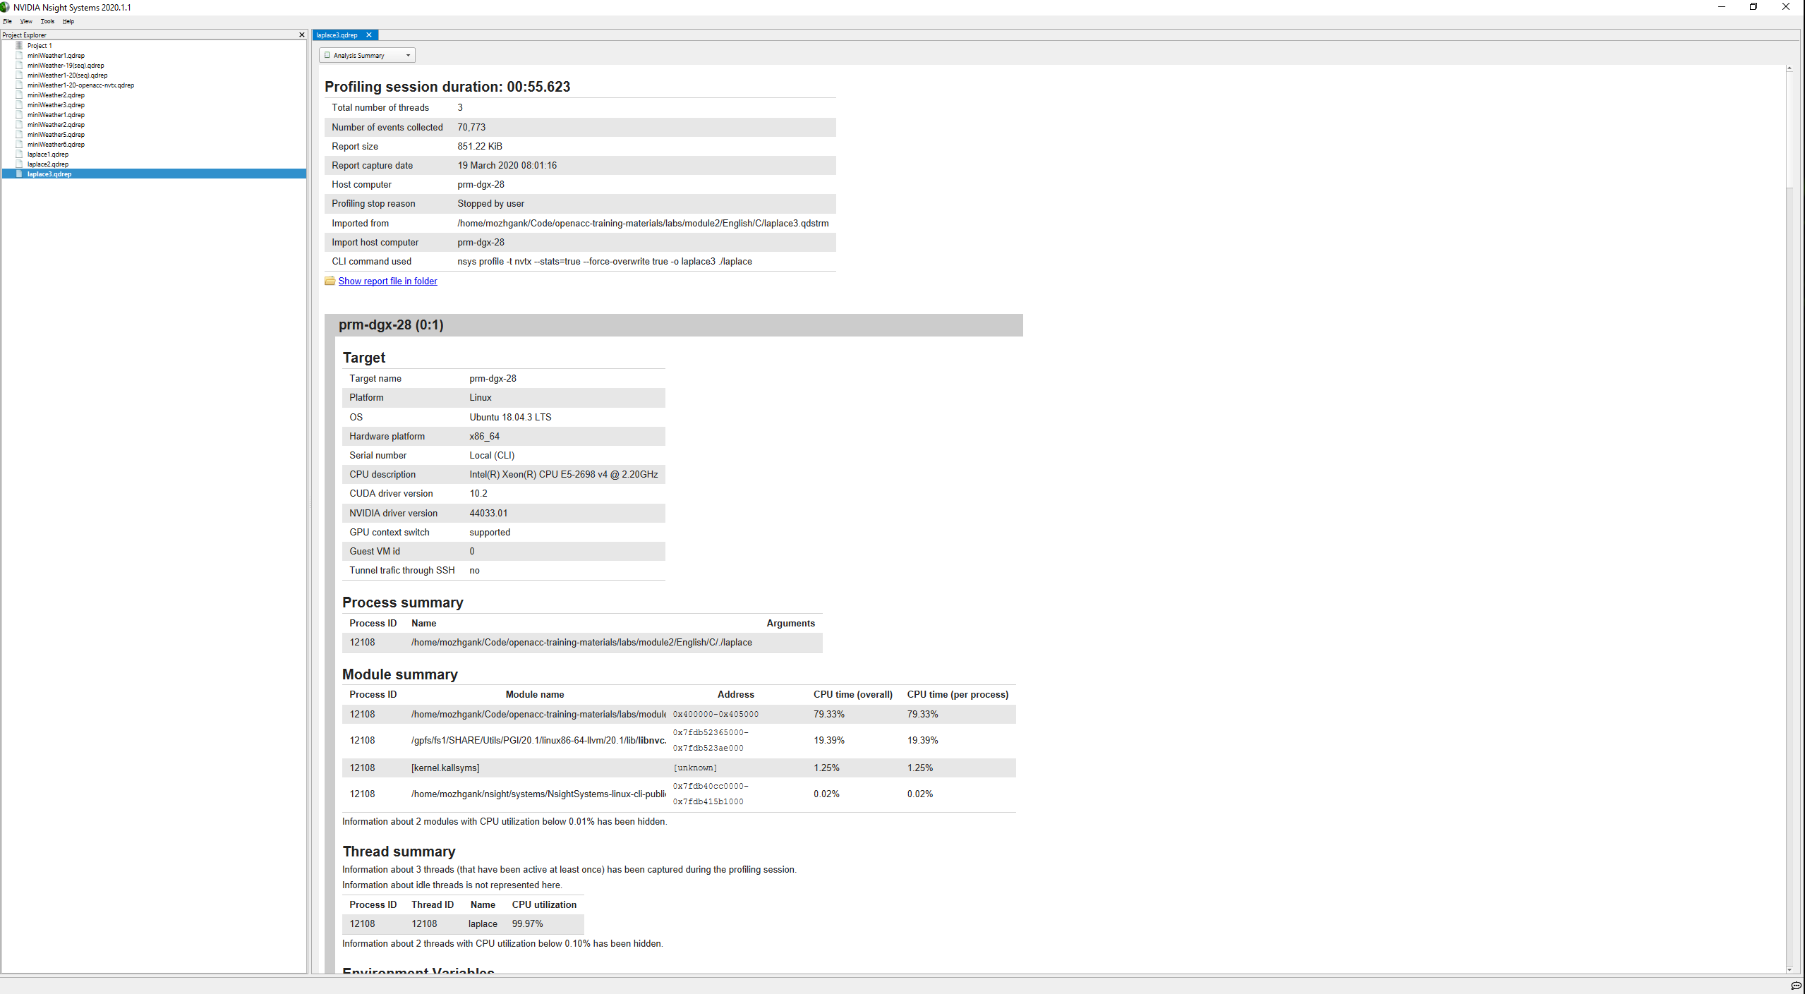
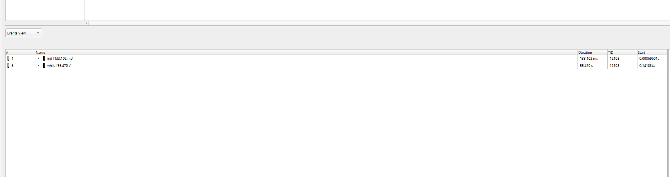
Profiling Sequential code
Using Nsight Systems
Timeline view
(charts and the hierarchy on the top pane)
Analysis Summary
Timeline view
(event view and function table on the bottom pane)
Notes:
And here you can see the screenshot of different reports

Slide 22
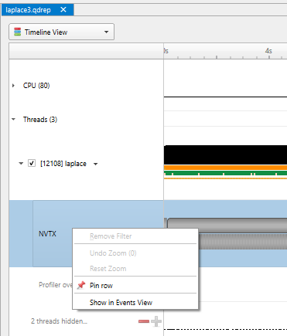
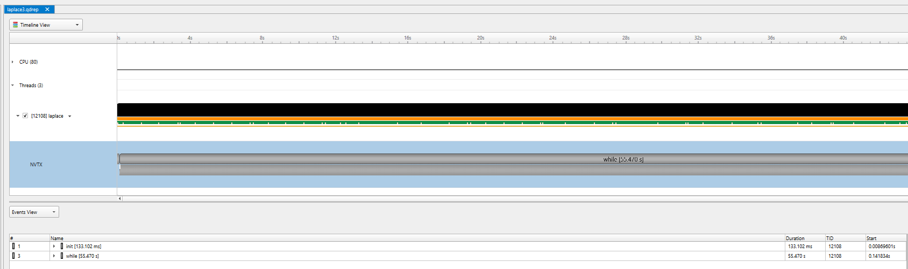
Profiling Sequential code
Viewing captured NVTX events and time ranges via Nsight Systems GUI
From the Timeline view, right click on the “NVTX” from the top pane and choose “Show in Events View”.
From the bottom pane, you can now see name of the events captured with the duration.
Notes:
Here is a screenshot of nvtx events we captured I the timeline view

Slide 23
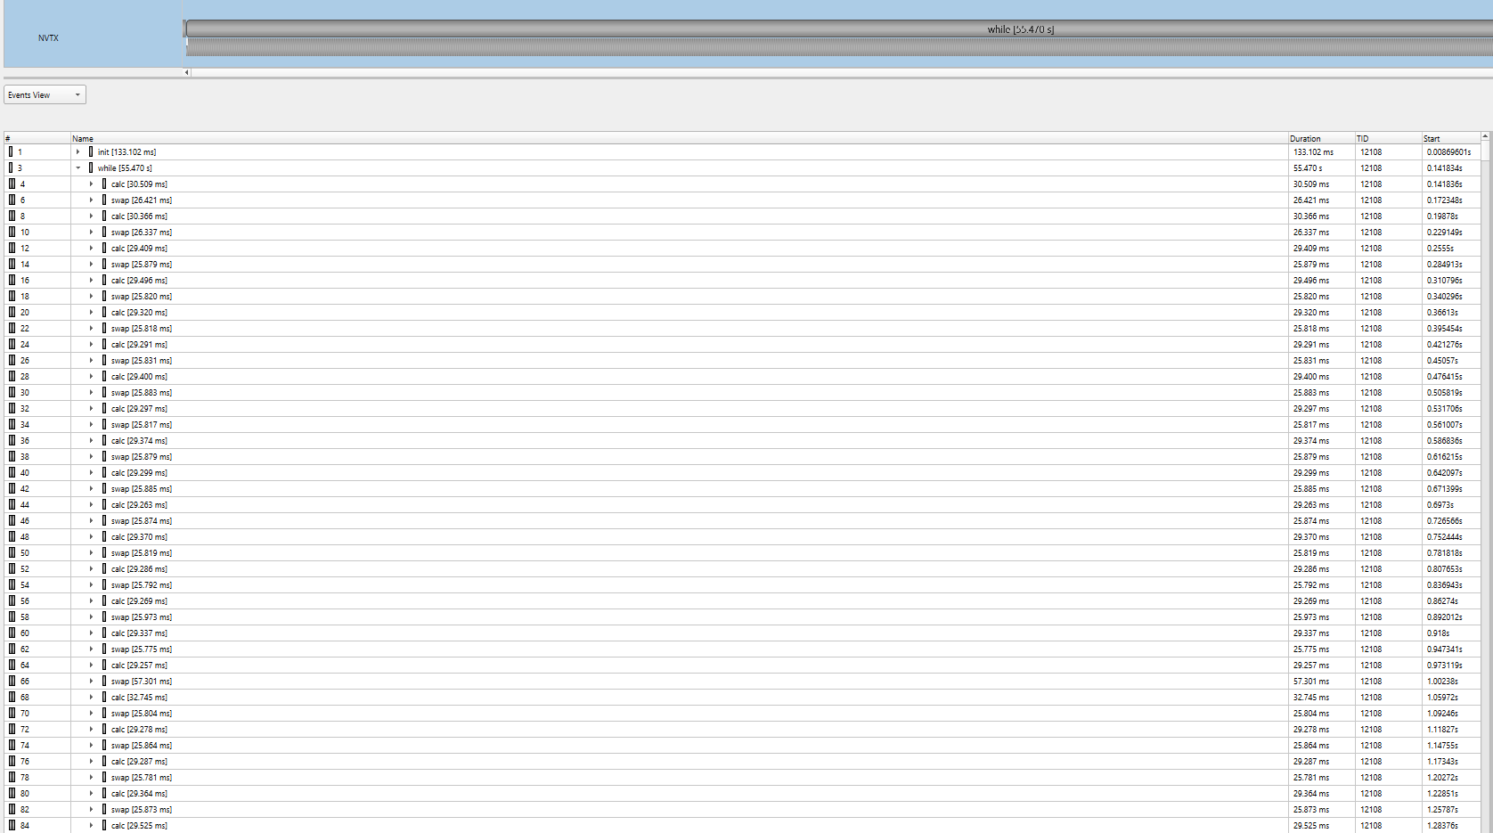
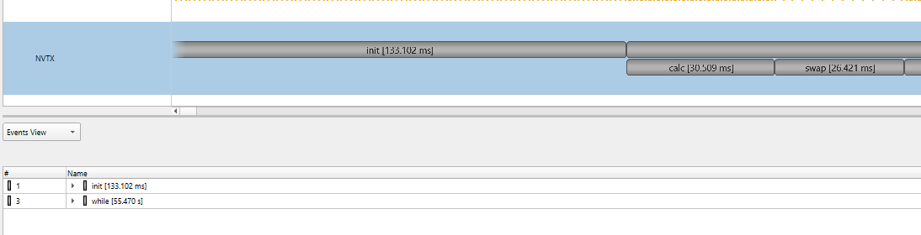
Profiling Sequential code
Viewing captured NVTX events and time ranges via Nsight Systems GUI
1
To have a closer look at events captured by NVTX APIs from GUI, you have two options:
Double click on “while” from the bottom pane and expand it.
Hover over the top pane and zoom in the chart on the right.
2
Notes:
These are just some other views, you can simply click on them on the timeline and see more information in the events view. You can also sort them by duration for example

Slide 24
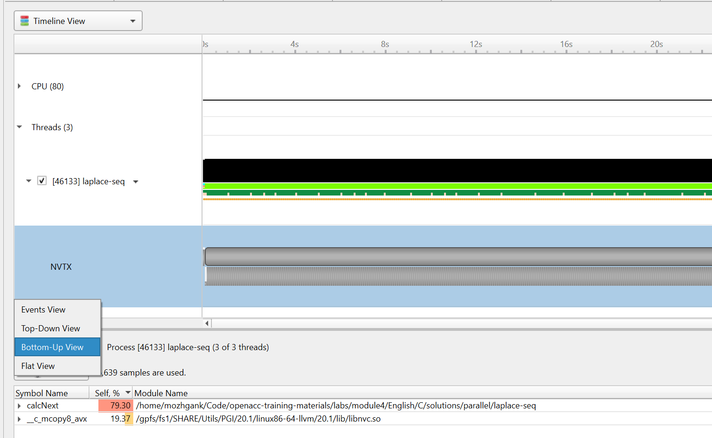
Profiling Sequential code
Viewing collected backtraces via Nsight Systems GUI
In the bottom pane, from the function table mode, choose the “Bottom-Up View” trying to find specific bottleneck functions that can be optimized.
In this example, we can see the “calcNext” and “c_mcopy8” (this is actually a compiler optimization that is being applied to our “swap” function) are places that our application is spending more of its time.
Notes:
Each of the views helps understand particular performance issues of the application being profiled

Slide 25
Profiling sequential code
Step 2: Profile Your Code
Lab Code: Laplace Heat Transfer
Obtain detailed information about how the code ran.
Total Runtime: 39.43 seconds
This can include information such as:
Total runtime
Runtime of individual routines
Hardware counters
Identify the portions of code that took the longest to run. We want to focus on these “hotspots” when parallelizing.
Notes:
Same slide as earlier – a recap. Now with the chart that matches our laplace code.

Slide 26
Profiling sequential code
Step 3: Identify Parallelism
Observe the loops contained within the identified hotspots
void pairing(int *input, int *output, int N){
for(int i = 0; i < N; i++)
output[i] = input[i*2] + input[i*2+1];
}
Are these loops parallelizable?
Can the loop iterations execute independently of each other?
Are the loops multi-dimensional, and does that make them very large?
6
3
10
7
2
4
input
Loops that are good to parallelize tend to have a lot of iterations to map to parallel hardware.
9
17
6
output
Notes:
Identifying parallelism is a bit of a manual step. Once the hotspots are identified the programmer needs to look at the loops and determine which are good candidates for directives.

Slide 27
profiling multicore code

Slide 28


Profiling multicore code
What is multicore?
CPU
Multicore refers to using a CPU with multiple computational cores as our parallel device
These cores can run independently of each other, but have shared access to memory
Loop iterations can be spread across CPU threads and can utilize SIMD/vector instructions (SSE, AVX, etc.)
Parallelizing on a multicore CPU is a good starting place, since data management is unnecessary
Notes:
The two parallel architectures we will be focusing on is multicore CPUs and GPUs. We will start with multicore CPUs because it is relatively easy to program compared to GPUs, since there’s only one memory space. In this module, we will also focus on profiling multicore code, with more GPU profiling in later modules.

Slide 29
Profiling multicore code
Using a multicore CPU with OpenACC
Host
Device
OpenACC’s generic model involves a combination of a host and a device
Host generally means a CPU, and the device is some parallel hardware
When running with a multicore CPU as our device, typically this means that our host/device will be the same
This also means that their memories will be the same
Host Memory
Device Memory
Notes:
Thinking back to our introduction of OpenACC as a general parallel model, we can now apply this model to a multicore CPU.

Slide 30
Profiling multicore code
Using a multicore CPU with OpenACC
Host/Device
OpenACC’s generic model involves a combination of a host and a device
Host generally means a CPU, and the device is some parallel hardware
When running with a multicore CPU as our device, typically this means that our host/device will be the same
This also means that their memories will be the same
Host/Device Memory
Host Memory
Notes:
Memory management for a multicore CPU target is fairly trivial. Also, achieving good performance through parallelism is relatively easy when programming for a multicore CPU. Optimizing our multicore CPU code often takes little work.

Slide 31
Profiling multicore code
Comping code for a specific parallel hardware
The ‘-ta’ flag will allow us to compile our code for a specific, target parallel hardware
‘ta’ stands for “Target Accelerator,” an accelerator being another way to refer to a parallel hardware
Our OpenACC code can be compiled for many different kinds of parallel hardware without having to change the code
$ pgcc –fast –Minfo=accel –ta=multicore laplace2d.c
calcNext:
35, Generating Multicore code
36, #pragma acc loop gang
Notes:
For right now, we will be focusing on a multicore target. Multicore is easier to program for, and serves much better as an introduction. It is still important to recognize that even if we are running our code on a multicore CPU, we could take the same code and run it on many different architectures.

Slide 32
profiling OPENACC code

Slide 33
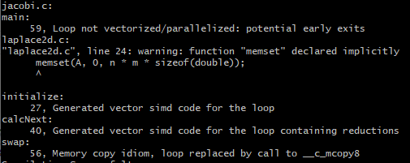
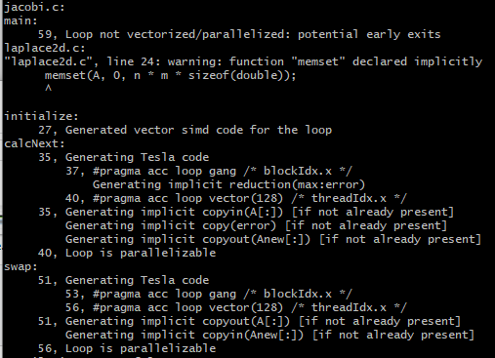
Parallel vs sequential
Compiler feedback
Have a close look at the PGI compiler feedback for both sequential and parallel implementation of the application.
It provides information about how your program was optimized or why a particular optimization was not made.
Note: Adding –Minfo flag or -Minfo=accel or -Minfo=all when compiling, will enable compiler feedback messages, giving details about the parallel code generated.
Sequential
Parallel
This material is released by NVIDIA Corporation under the Creative Commons Attribution 4.0 International (CC BY 4.0)
Notes:
Make sure to study the compiler feedback. Turn it on by using –Minfo flag at the compile time
Compiler feedback gives more detailed message about the parallel code generated
In the lab, there are examples of the compiler feedback with detailed explanation.

Slide 34
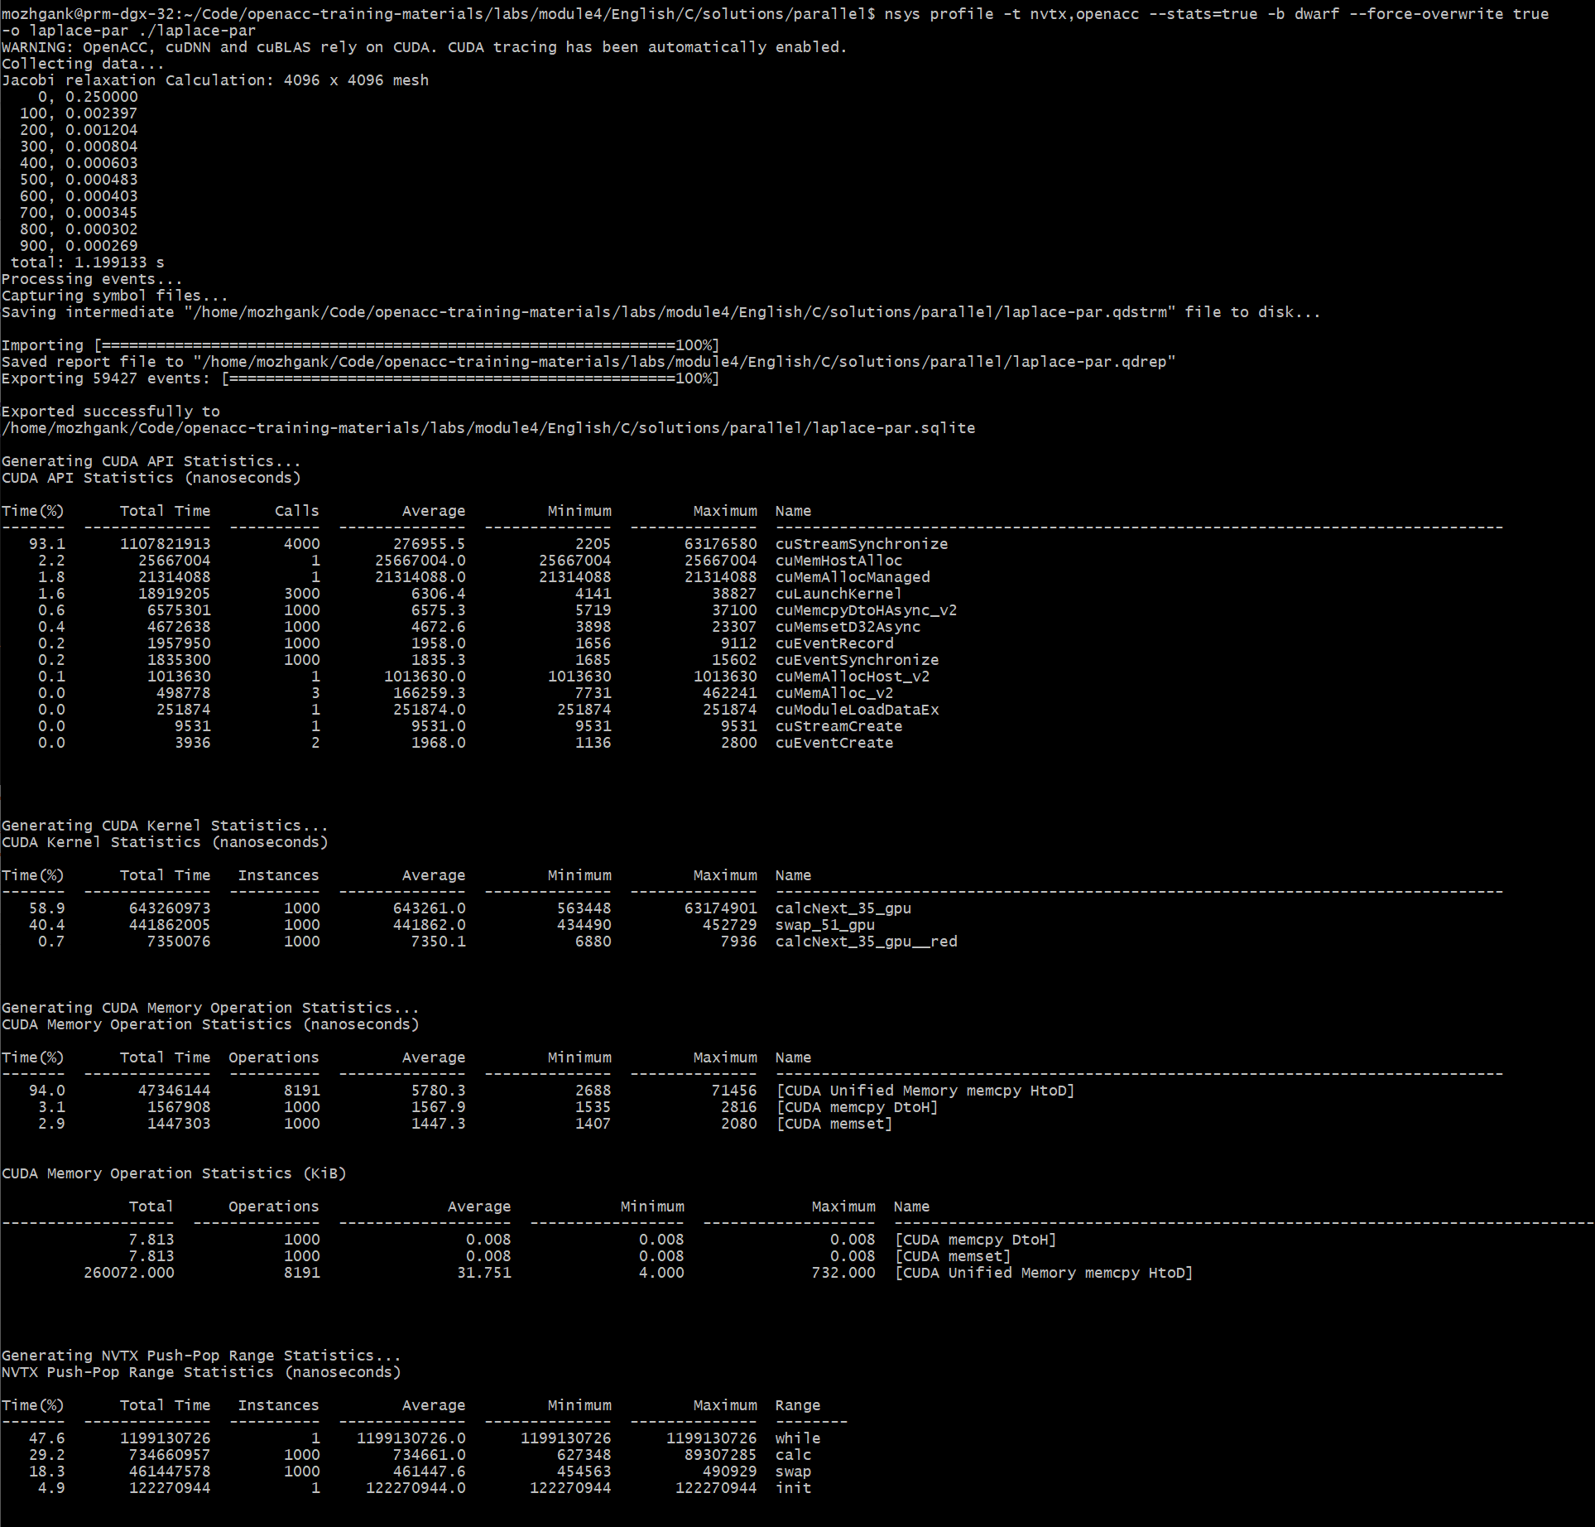
#include <math.h>
#include <stdlib.h>
#define OFFSET(x, y, m) (((x)*(m)) + (y))
void initialize(double *restrict A, double *restrict Anew, int m, int n)
{
memset(A, 0, n * m * sizeof(double));
memset(Anew, 0, n * m * sizeof(double));
for(int i = 0; i < m; i++){
A[i] = 1.0;
Anew[i] = 1.0;
}
}
double calcNext(double *restrict A, double *restrict Anew, int m, int n)
{
double error = 0.0;
#pragma acc parallel loop reduction(max:err)
for( int j = 1; j < n-1; j++)
{
#pragma acc loop
for( int i = 1; i < m-1; i++ )
{
Anew[OFFSET(j, i, m)] = 0.25 * ( A[OFFSET(j, i+1, m)] + A[OFFSET(j, i-1, m)]
+ A[OFFSET(j-1, i, m)] + A[OFFSET(j+1, i, m)]);
error = max( error, fabs(Anew[OFFSET(j, i, m)] - A[OFFSET(j, i , m)]));
}
}
return error;
}
void swap(double *restrict A, double *restrict Anew, int m, int n)
{
#pragma acc parallel loop
for( int j = 1; j < n-1; j++)
{
#pragma acc loop
for( int i = 1; i < m-1; i++ )
{
A[OFFSET(j, i, m)] = Anew[OFFSET(j, i, m)];
}
}
}
void deallocate(double *restrict A, double *restrict Anew)
{
free(A);
free(Anew);
}
CUDA API statistics
CUDA Kernel statistics
CUDA Memory Operation statistics
NVTX range statistics
laplace2d.c
(Parallelised using OpenACC parallel directives (pragmas highlighted)
“calc” region (calcNext function) takes 29.2%
“swap” region (swap function) takes 18.3% of total execution time
Open laplace-par.qdrep with Nsight System GUI to view the timeline
Notes:
Parallel compilation
Here is the screenshot of parallel laplase code using openacc and you can see that we get all these statistics on the terminal with we profile it with nsys

Slide 35
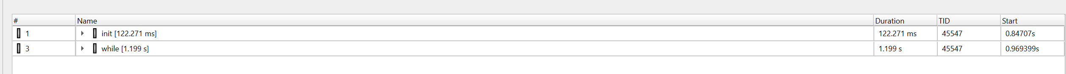
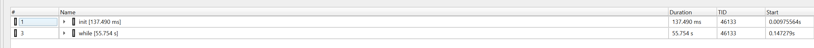
Parallel vs sequential Speedup
Viewing captured NVTX events
Have a close look at the captured NVTX events for both serial and parallel implementations.
Time spent in “while” loop has significantly decreased.
Achieved speedup: ~47
Parallel
Sequential
Parallel
Sequential

Slide 36
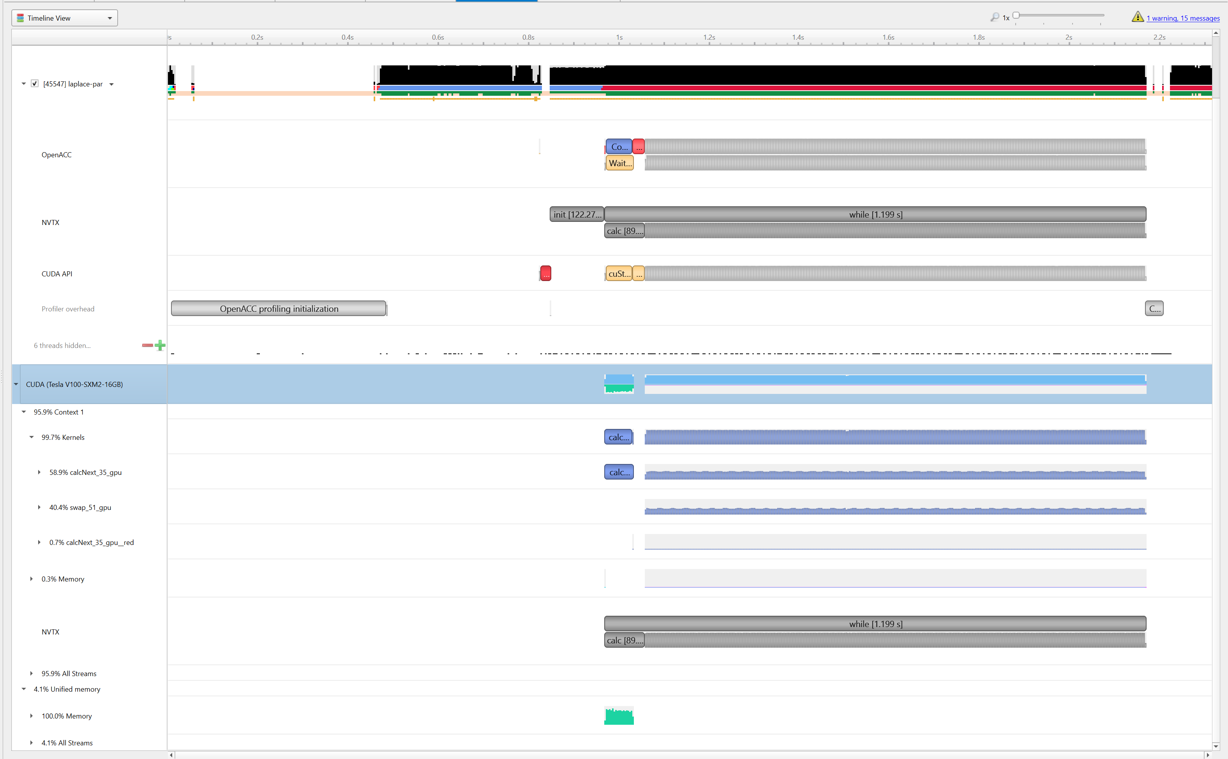
Profiling Parallel code
Viewing timeline via Nsight Systems
Contents of the tree-like hierarchy on the left depend on the project settings used to collect this report.
If a certain feature has not been enabled, corresponding rows will not be shown on the timeline.
In this example, we chose to trace NVTX and OpenACC while sampling.
Note: Kernel launches are represented by blue and memory transfers are displayed in green.
Notes:
Here is a timeline view of the parallel laplace code. Kernel launches are represented by blue color here.

Slide 37
Lab code

Slide 38
Laplace heat transfer
Introduction to lab code - visual
Very Hot
Room Temp
We will observe a simple simulation of heat distributing across a metal plate.
We will apply a consistent heat to the top of the plate.
Then, we will simulate the heat distributing across the plate.

Slide 39
Laplace heat transfer
Introduction to lab code - technical
The lab simulates a very basic 2-dimensional heat transfer problem. We have two 2-dimensional arrays, A and Anew.
A
Anew
0.0
0.0
0.0
0.0
0.0
0.0
0.0
0.0
The arrays represent a 2-dimensional, metal plate. Each element in the array is a double value that represents temperature.
0.0
0.0
0.0
0.0
0.0
0.0
0.0
0.0
0.0
0.0
0.0
0.0
0.0
0.0
0.0
0.0
We will simulate the distribution of heat until a minimum change value is achieved, or until we exceed a maximum number of iterations.
0.0
0.0
0.0
0.0
0.0
0.0
0.0
0.0
Notes:
Our code has two 2-dimensional arrays, A and Anew. These arrays contain double values, and these doubles represent a temperature. The 2-D array itself represents a flat metal plate, and each element is some portion of that plate that contains a temperature.
We initialize our arrays be “heating” one side of the plate. So, on the top side of the plate, we set all of the values to 1.0.
Our calcNext function will look at each of the inner positions of the plate, and update its temperature based on its neighbors. The temperature will be set to the average temperature of its four neighbors.
Then lastly, the contents of Anew will be copied back to A. Then calcNext will be called again, until our answer is computed.

Slide 40
Laplace heat transfer
Introduction to lab code - technical
We initialize the top row to be a temperature of 1.0
A
Anew
The calcNext function will iterate through all of the inner elements of array A, and update the corresponding elements in Anew
0.0
1.0
0.0
1.0
0.0
1.0
0.0
1.0
0.0
1.0
0.0
1.0
0.0
1.0
0.0
1.0
0.0
0.0
0.0
0.0
0.0
0.25
0.25
0.0
0.0
0.0
0.0
0.0
0.0
0.0
0.0
We will take the average of the neighboring cells, and record it in Anew.
0.0
0.0
0.0
0.0
0.0
0.0
0.0
0.0
0.0
0.0
0.0
0.0
0.0
0.0
0.0
The swap function will copy the contents of Anew to A
Notes:
Our code has two 2-dimensional arrays, A and Anew. These arrays contain double values, and these doubles represent a temperature. The 2-D array itself represents a flat metal plate, and each element is some portion of that plate that contains a temperature.
We initialize our arrays be “heating” one side of the plate. So, on the top side of the plate, we set all of the values to 1.0.
Our calcNext function will look at each of the inner positions of the plate, and update its temperature based on its neighbors. The temperature will be set to the average temperature of its four neighbors.
Then lastly, the contents of Anew will be copied back to A. Then calcNext will be called again, until our answer is computed.

Slide 41
Laplace heat transfer
Introduction to lab code
A
Anew
1.0
1.0
1.0
1.0
1.0
1.0
1.0
1.0
0.0
0.25
0.25
0.0
0.0
0.25
0.25
0.0
0.0
0.0
0.0
0.0
0.0
0.0
0.0
0.0
0.0
0.0
0.0
0.0
0.0
0.0
0.0
0.0
The swap function will copy the contents of Anew to A

Slide 42
KEY concepts
In this module we discussed…
Compiling sequential and parallel code
CPU profiling for sequential and parallel execution with NVTX
Specifics of our Laplace Heat Transfer lab code

Slide 43
Lab Goals
In this lab you will do the following…
Build and run the example code using the NVIDIA’s HPC compiler
Use Nsight Systems to understand where the program spends its time

Slide 44
THANK YOU

